Slide 1
REPORTS

Slide 2

Reports
1. Click on the link to open the reports module.
Daily Reports- The Patient Report and Daily Log should be run every day.

Slide 3

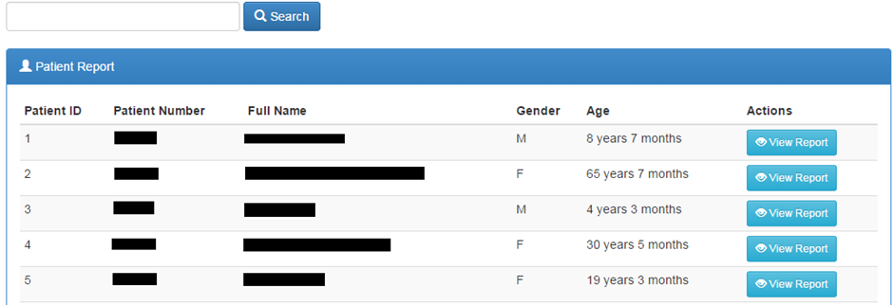
Patient Report
1. Click the link on the Reports sub-menu to open the patients reports listing

Slide 4



Continuation….
2. Search for the patient by Patient Name, Patient Number, or Patient ID.
3. Click the button to start search.
4. Select the patient you want from the list if more than one patient matches your search criteria.
5. Click to see all data for that patient.
6. Click to filter the report.

Slide 5

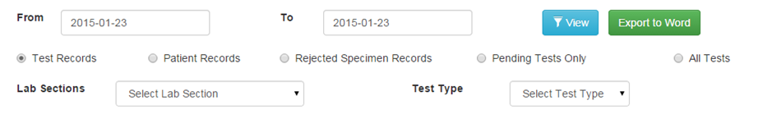
Daily Log
1. Click the sub-menu under reports to view daily logs.
2. Set the date range to reflect the log to print. You can run a report of the day’s activity by patients seen (by clicking Patient Records), or by tests run (by clicking Test Records) or rejected specimens (by clicking Rejected Specimen Records).

Slide 6
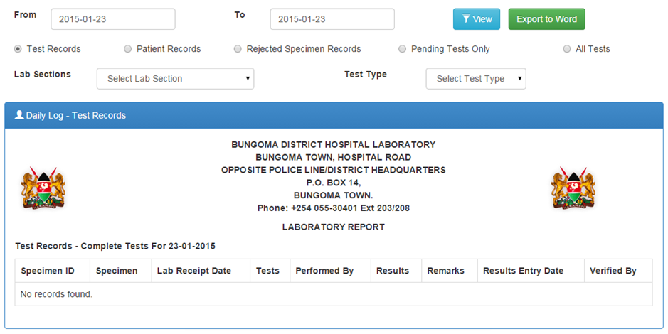
Test Records
You can choose to run a log for one lab section or for one type of test, for all tests or pending tests only. The report loads with Export controls at the top of the page

Slide 7




Patient Records
1. Click on the checkbox
2. Apply the filter parameters, such as date ranges
3. Click the button to load the report
4. Click the button to toggle the summary
5. Click the button to export the report to word document for further processing

Slide 8
Aggregate Reports
These are accrued summaries over a period of time.

Slide 9


Prevalence Rates
Gives the prevalence of a particular laboratory test result based on the number of tests done and the results.
1. Click the sub-menu to load the report. By default, the report loads prevalence rates for the current year .
2. Set a date range to view infection graph and prevalence rates. You can also specify the lab section.
3. Click the button to load the report with the filters you defined
4. You can view a numeric summary of the prevalence rates by clicking the button to reveal the numeric data.
5. You can click on a test on the legend section to hide its graph

Slide 10

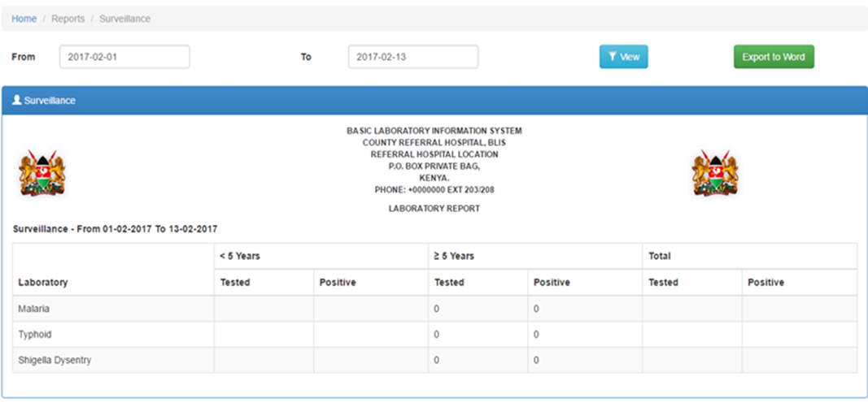
Surveillance Report
Allows you to generate surveillance report by laboratory and test outcome.
1. Click sub-menu to load the report. By default, it loads surveillance for the current month.
2. Set a date range to see all test results after clicking the button.

Slide 11

Counts Report
Generates a report for a particular time period of the number of tests and specimens both grouped and ungrouped.
1. Click the sub-menu to launch the counts reports options

Slide 12
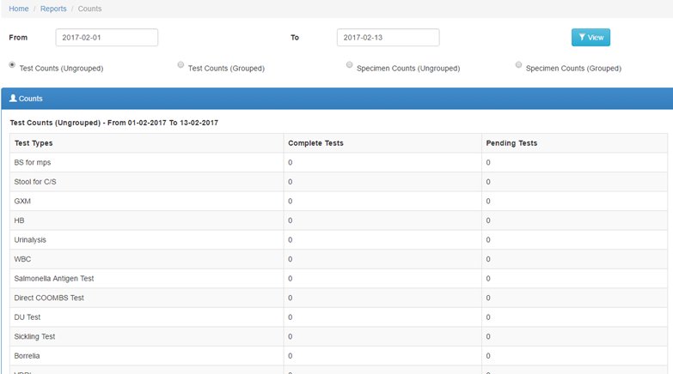
Test Counts (Ungrouped)
Shows for each test, the number of complete vs pending tests overtime

Slide 13


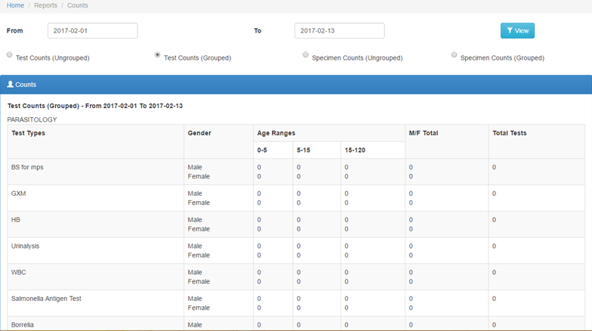
Test counts (Grouped)
This is a report that groups tests according to various parameters such as lab section, gender, age ranges then counts the numbers for each while showing the total tests run.
Click the checkbox then to load the report

Slide 14
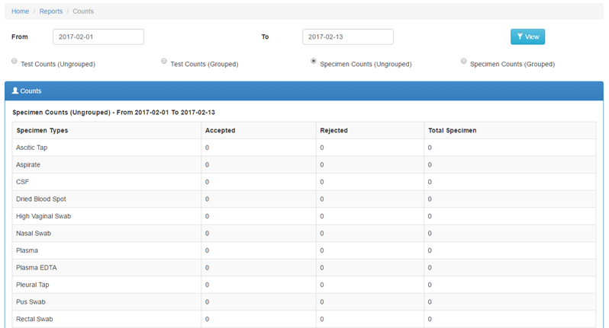
Specimen counts (Ungrouped)
It is a count for accepted vs rejected specimen
Click the then to load the report

Slide 15

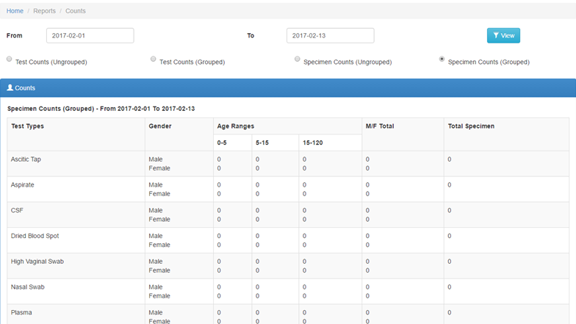
Specimen Counts (Grouped)
Click the checkbox then to load the report

Slide 16



Turnaround Time Report
Allows you to see actual turnaround times between test order and completion for all or specific tests.
1. Click the sub-menu to load the report
2. Set a date range then click the button to filter the report. The default is data for the current year.
3. You can choose to run a log for one lab section or for one type of test. The default settings are test records, all sections, and all tests.
4. The report loads with Export controls which can be accessed by clicking the icon where the chart can be exported to PDF document or as an image.

Slide 17

Infection Report
Allows you to generate reports of infections by patient age and gender.
1. Click sub-menu to load the report. By default, it loads data counts for the current year.
2. Set a date range or select one Lab Section, or all sections to see all test results after clicking the button.

Slide 18
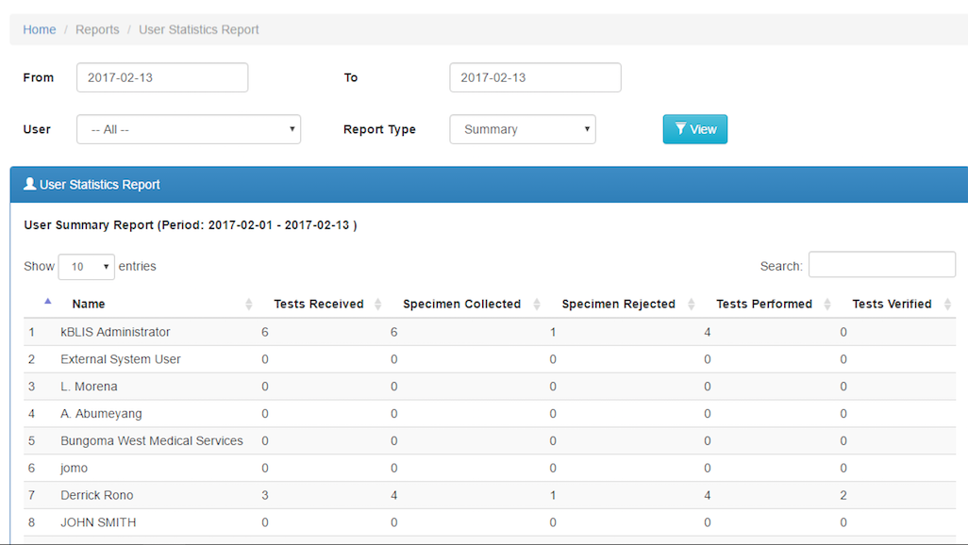
User Statistics Report

Slide 19
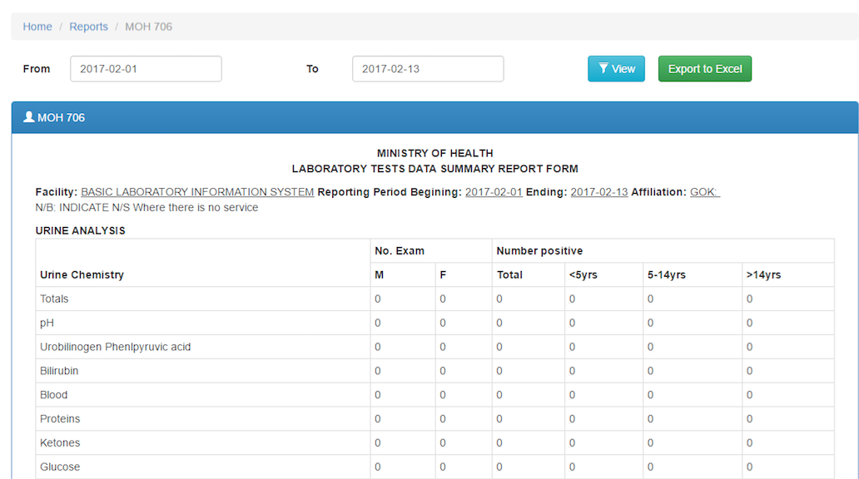
MoH Report

Slide 20
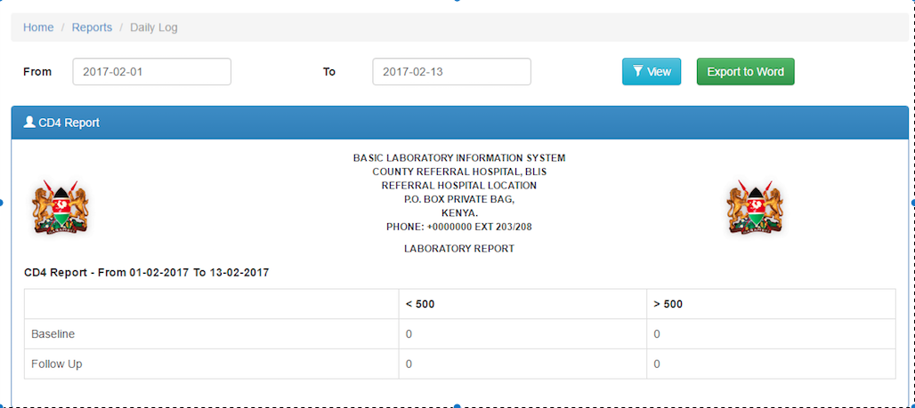
CD4 Report

Slide 21

Quality Control Report
Allows you to generate quality control report by range and control type.
1. Click sub-menu to load the report. By default, it loads quality control report for the current month.
2. Set the date range and select the control type to see all the results after clicking the button.

Slide 22
Specimen Rejection Report

